Slide 1

World Education Analysis
PDAS CA1 Assignment
Hubert Heng
2214494
DAAA1B02

Slide 2
Objectives
To find out how does the school life expectancy in countries affects the daily mean income/expenditure, unemployment rates and the poverty rates in those countries

Slide 3
Factors needed and their respective Datasets
School Life Expectancy (in terms of years, 2000 to 2019)
school-life-expectancy-annual.csv
expected-years-of-schooling.csv
Mean daily Income (annually, in US dollars)
daily-mean-income.csv
Unemployment Rate (% percent)
unemployment-rate.csv
Poverty Rate (% percent, those living under 60% of the median expenditure)
relative-poverty-share-of-people-below-60-of-the-median.csv

Slide 4
Dataset links
school-life-expectancy-annual.csv
  https://data.gov.sg/dataset/school-life-expectancy
expected-years-of-schooling.csv
  https://ourworldindata.org/grapher/expected-years-of-schooling
daily-mean-income.csv
  https://ourworldindata.org/grapher/daily-mean-income?country=~High+income+countries
unemployment-rate.csv
  https://ourworldindata.org/grapher/unemployment-rate
relative-poverty-share-of-people-below-60-of-the-median.csv
  https://ourworldindata.org/grapher/relative-poverty-share-of-people-below-60-of-the-median?country=LUX~BRA~ZMB

Slide 5
Filename: | No. of Data-fields | Size
school-life-expectancy-annual.csv | 2 | 249 bytes
Type of Data
Shows the expected number of years of education that a 6 year old child can expect to enrol in over his/her lifetime, given the current enrolment rates
Data-field | Description
year | Datetime (Year) “YYYY”
school_life_expectancy | Number of years of education
Peculiarities about the dataset
nil

Slide 6
Filename: | No. of Data-fields | Size
expected-years-of-schooling.csv | 4 | 179 KB
Type of Data
Shows the number of years a child of school entrance age can expect to receive if the current age-specific enrollment rates persist throughout the child’s years of schooling
Data-field | Description
Entity | Full name of Country
Code | Code of Country
Year | Datetime (Year) “YYYY”
Expected Years of Schooling | Number of years of education
Peculiarities about the dataset
nil

Slide 7
Filename: | No. of Data-fields | Size
daily-mean-income.csv | 4 | 86.5 KB
Type of Data
Shows the mean income or expenditure per day in each country over the years
Data-field | Description
Entity | Full name of Country
Code | Code of Country
Year | Datetime (Year) “YYYY”
Mean income or expenditure per day | Mean income or expenditure per day (USD dollar)
Peculiarities about the dataset
Singapore is not included in the dataset

Slide 8
Filename: | No. of Data-fields | Size
unemployment-rate.csv | 4 | 225 KB
Type of Data
Shows the percentage of people unemployed in a country over the years
Data-field | Description
Entity | Full name of Country
Code | Code of Country
Year | Datetime (Year) “YYYY”
Unemployment, total (% of total labor force) (modeled ILO estimate) | Percentage of people unemployed
Peculiarities about the dataset
nil

Slide 9
Filename: | No. of Data-fields | Size
relative-poverty-share-of-people-below-60-of-the-median.csv | 4 | 75.5 KB
Type of Data
Shows relative poverty. Relative poverty is measured in terms of a poverty line that rises and falls over time with average incomes – in this case set at 60% of median expenditure.
Data-field | Description
Entity | Full name of Country
Code | Code of Country
Year | Datetime (Year) “YYYY”
60% of median - share of population below poverty line | Percentage of people below the poverty line (60% median expenditure)
Peculiarities about the dataset
Singapore is not included in the dataset

Slide 10
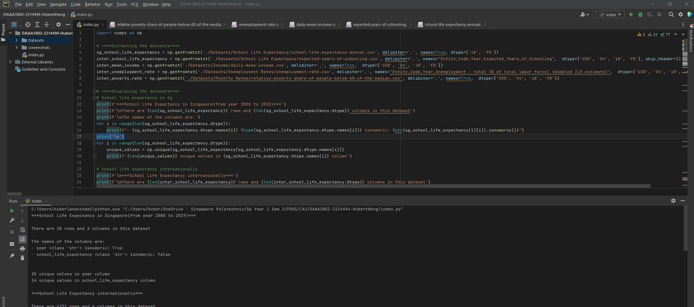
Displaying the Datasets

Slide 11
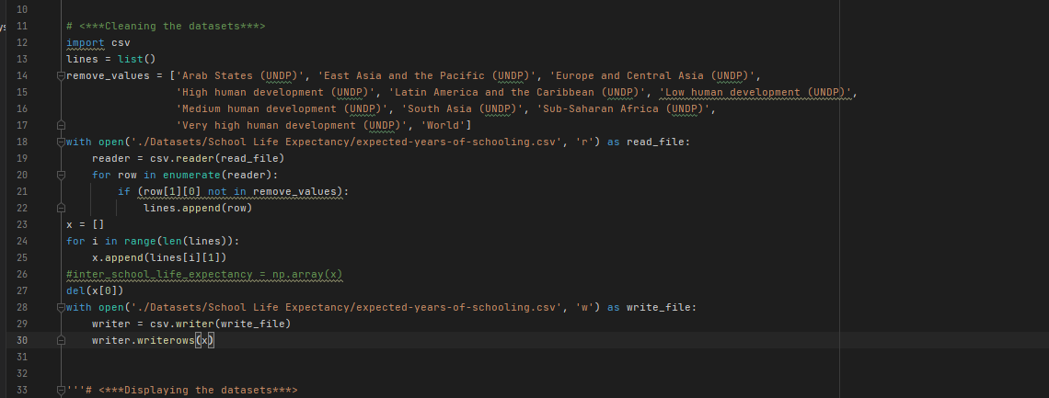
Cleaning the datasets
In the expected-years-of-schooling.csv dataset, there are entities that are regions instead of countries.
We have to clean this data out as it will affect our result findings (etc. mean school life expectancy)
To do this, we need to remove the rows containing the regions
Read the csv file in memory as a list, then edit that list(remove rows), and then write it back to the csv file
This data cleaning process only needs to be done once

Slide 12
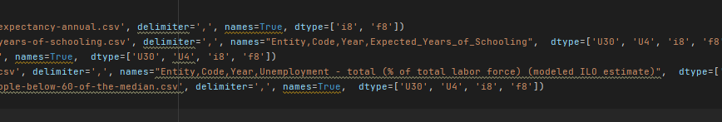
Cleaning the datasets
There was also the need to change the headers for the expect-years-of-schooling.csv and unemployment-rate.csv as they have special characters like “, ” or “ ” that messes up the code, like the delimiter etc
Hence, to solve this, simply type in the new headers in the “names=” field

Slide 13
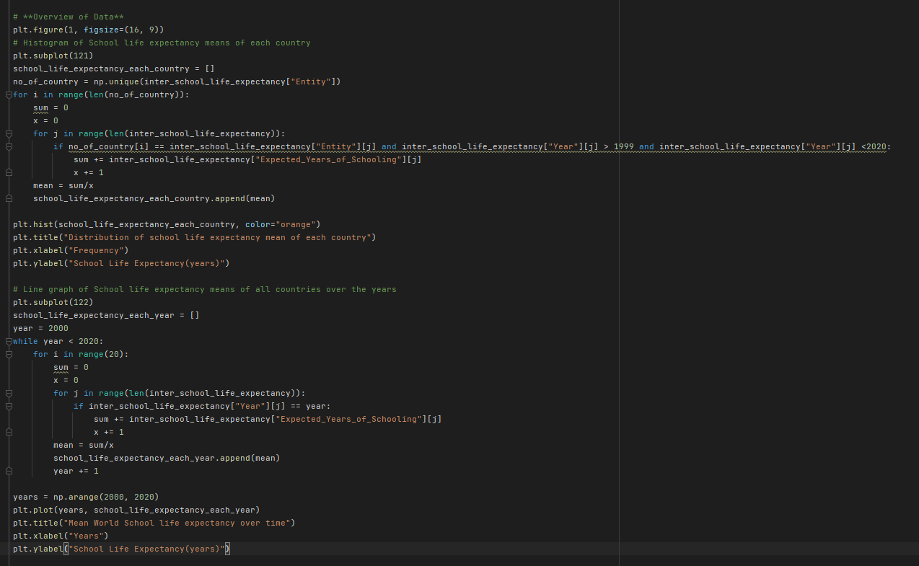
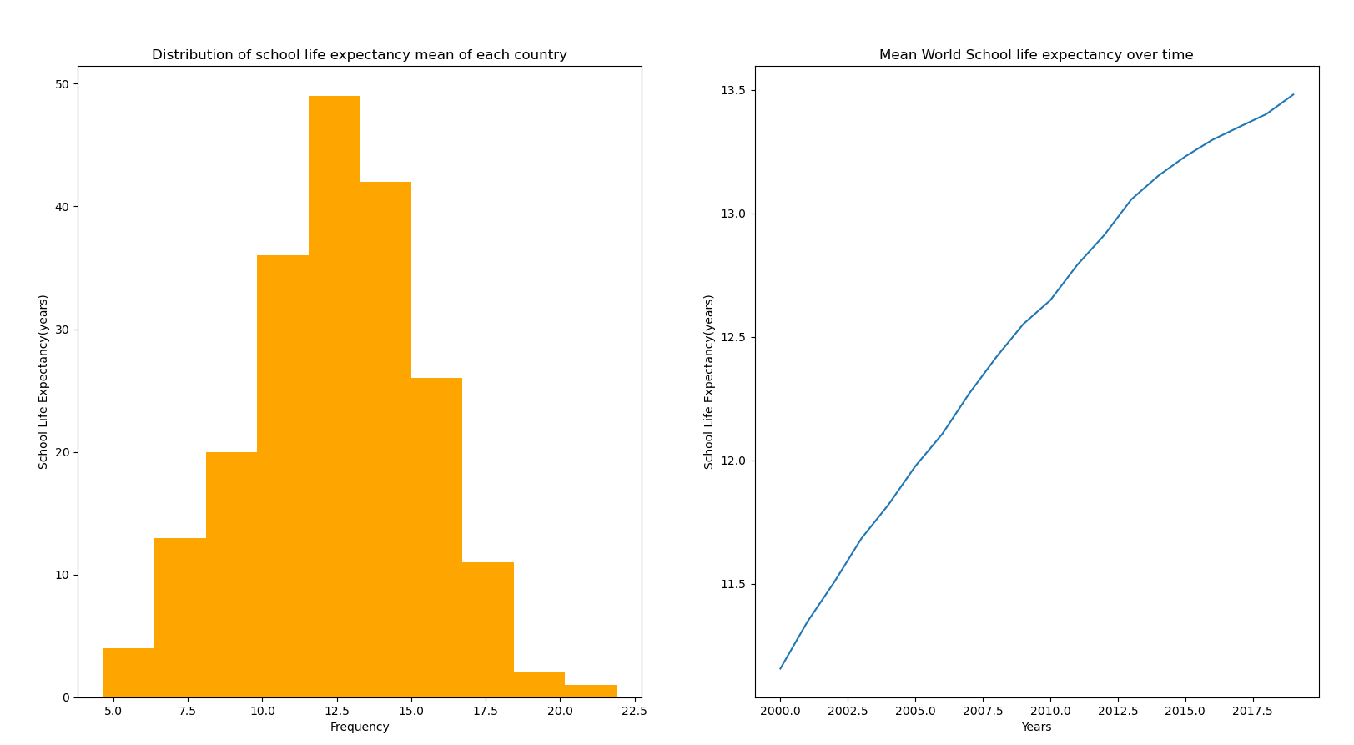
Visual Overview of Data (The World)
Using plt.hist and plt.plot, we can plot a histogram and a line graph.
The histogram on the left shows the distribution of the school life expectancy means of each country. The distribution is approximately symmetrical at the center, representing a normal distribution. The mean, median and mode are the about the same in a normal distribution, that is, 12.5 years of school life expectancy.
The line graph on the right shows the school life expectancy mean(worldwide) for each year. The line graph shows an increasing trend between time and the school life expectancy. Hence, we can conclude that as time pasts, the school life expectancy mean increases.

Slide 14
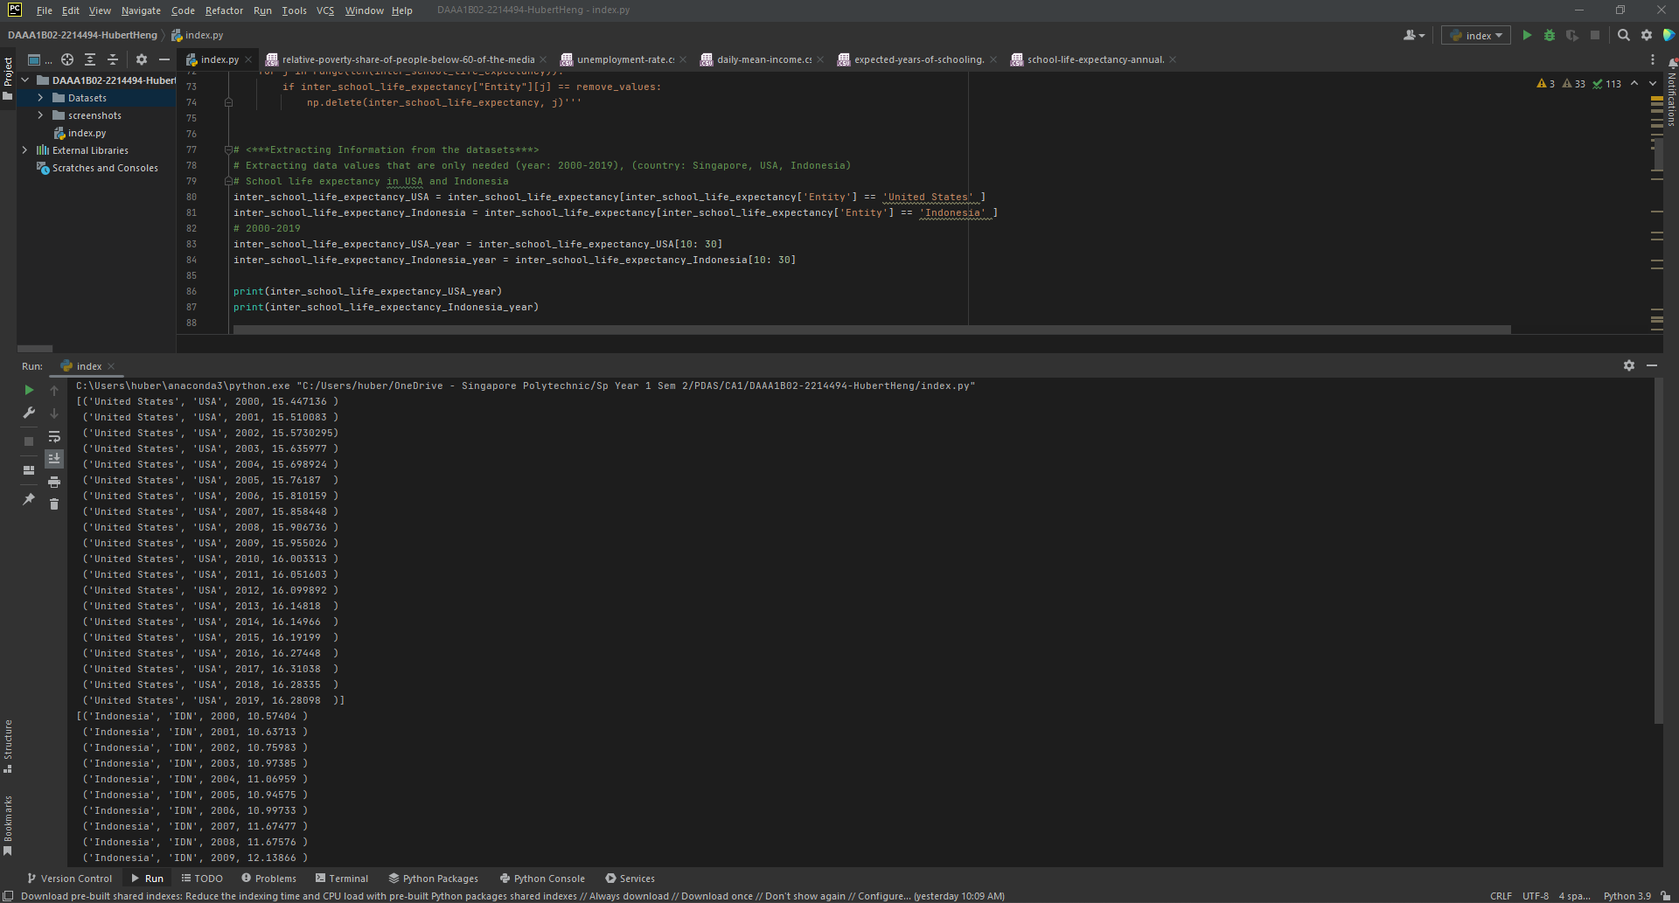
Visualisation of each country
Extract necessary rows from the expect-years-of-schooling.csv dataset, in this case, school life expectancy of each country from 2000 to 2019.
We do not need to extract school life expectancy of Singapore from 2000 to 2009 as we already have it in the school-life-expectancy-annual.csv dataset.

Slide 15
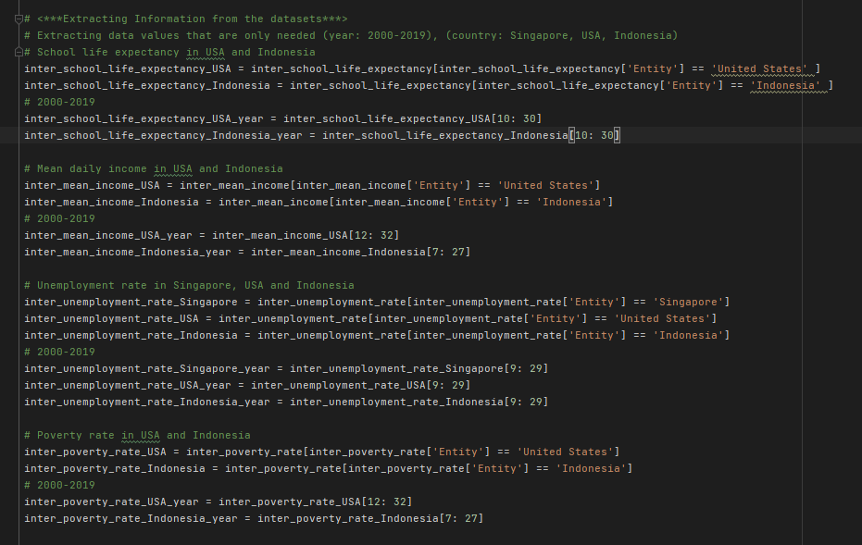
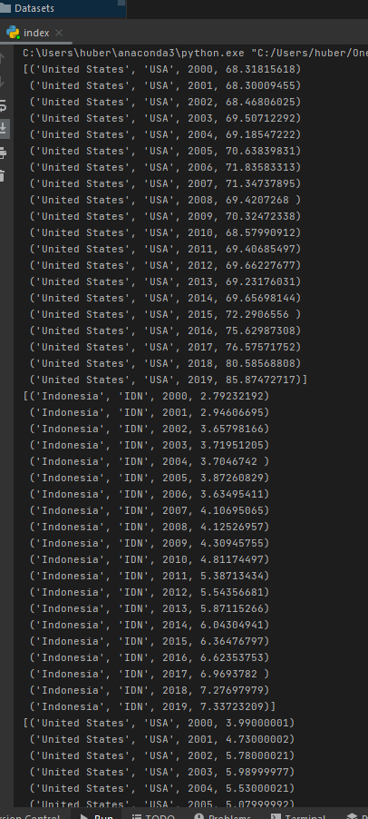
Visualisation of each country
Now before we explore the various factors in each country in detail, we need to, like before, extract necessary rows from the rest of the data sets
daily-mean-income.csv => mean daily income in each country from 2000 to 2019
unemployment-rate.csv => rate of unemployed people in a country from 2000 to 2019
relative-poverty-share-of-people-below-60-of-the-median.csv => rate of people under the 60% median
Lets use the countries Singapore, USA and Indonesia for our data anlaysis

Slide 16
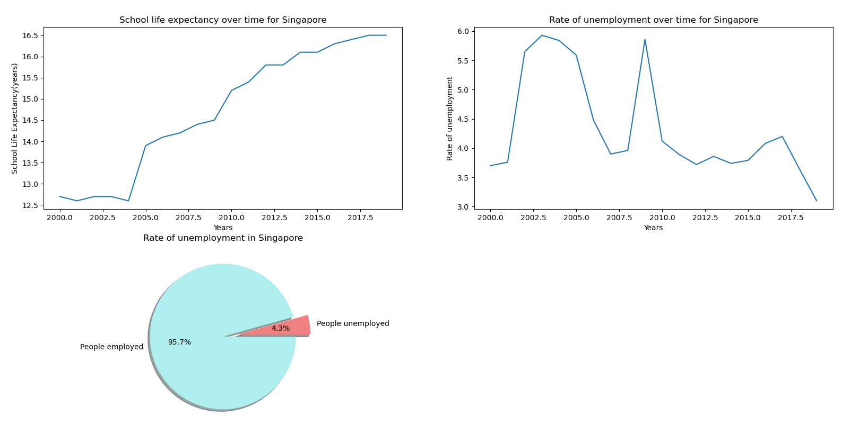
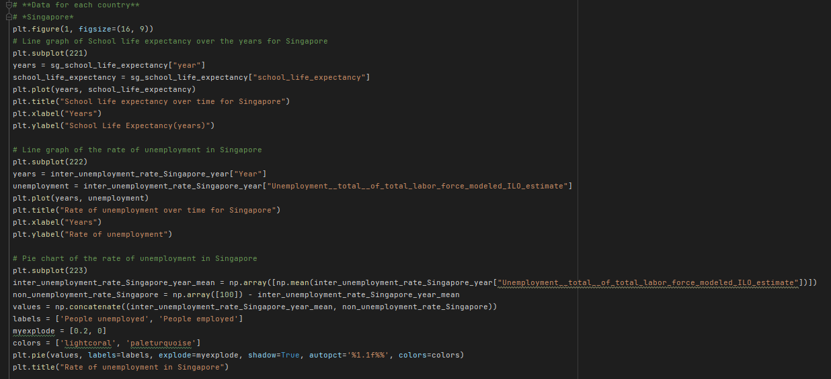
Visualisation of Singapore
Using plt.plot and plt.pie, we can plot two line graph and a pie chart
On the top left we have a line graph displaying the change of school life expectancy over time. In Singapore, as the years go on, the school life expectancy increases from around 12.75 to 16.5. There was a huge increase from around the year 2004 to 2005, where we saw an increase of school life expectancy from 12.6 to 14.0, an increase of 1.4 years.
On the top right we have a line graph displaying the rate of employment over time. Unfortunately it does not seem to have a relation with school life expectancy. It seems to be affected by other external factors.
At the bottom we have a pie chart displaying the mean proportion of the unemployed to the employed over the years in Singapore. The percentage of unemployed in Singapore is 4.3%.

Slide 17
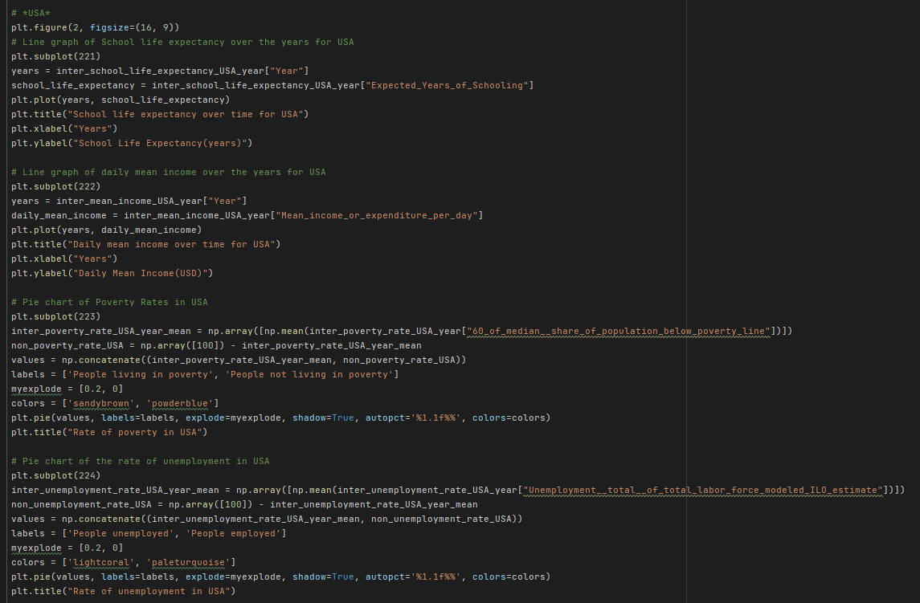
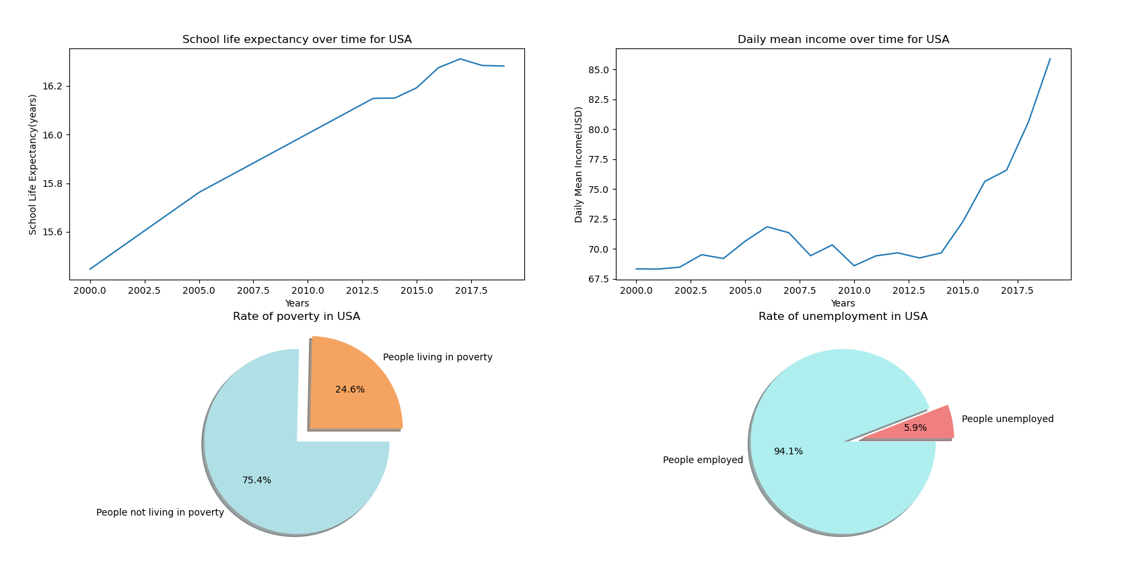
Visualisation of USA
Again using plt.plot and plt.pie, we can plot two line graphs and two pie charts
On the top left we have a line graph displaying the change of school life expectancy over time. In USA, as the years go on, the school life expectancy increases from around 15.4 to 16.5. There is not any huge increases during a certain period of time, the increase remained steady.
On the top right we have another line graph displaying the change of daily mean income over time. The line graph resembles an expontial curve, with the years 2000 to 2012 seeing hardy any increase in the daily mean income at all. The years 2012 to 2019, however, saw a huge spike increase, from 70 dollars daily to around 86 dollars daily.

Slide 18
Visualisation of USA
At the bottom left we have a pie chart displaying the mean proportion of those in poverty to those not in poverty over the years in USA. The percentage of those in poverty is disturbingly high for a first world country, at 24.6%.
At the bottom right we have a pie chart displaying the mean proportion of the unemployed to the employed over the years in USA. The percentage of unemployed in USA is 5.9%.

Slide 19
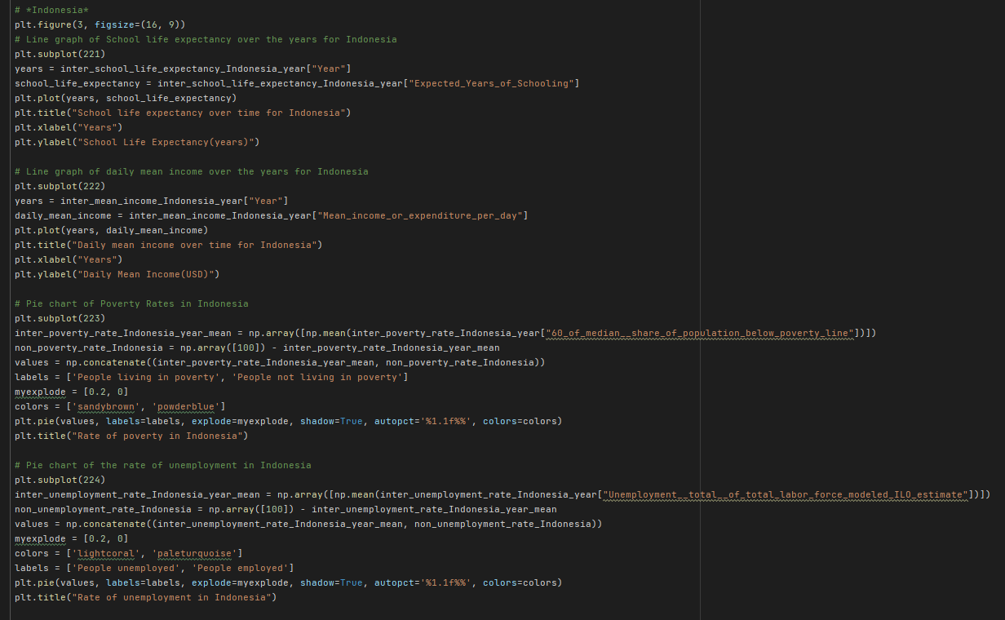
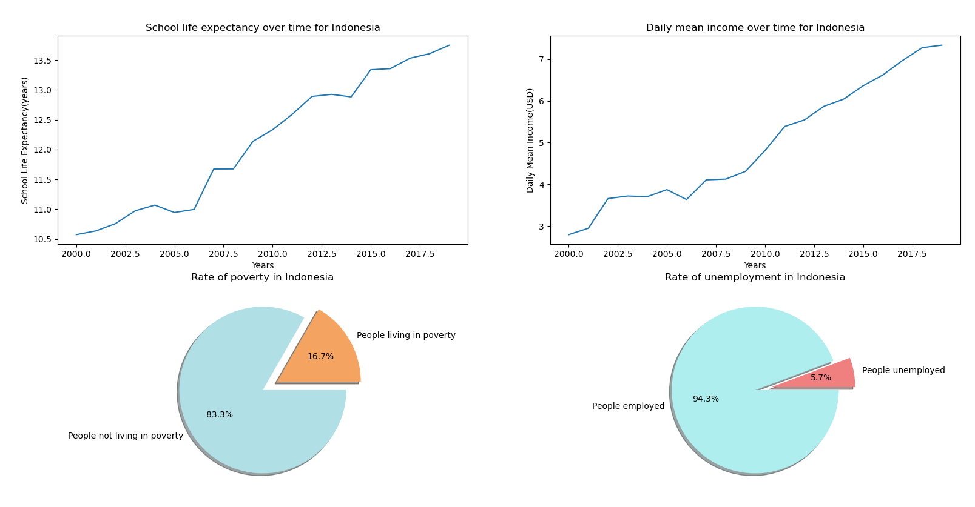
Visualisation of Indonesia
Again using plt.plot and plt.pie, we can plot two line graphs and two pie charts
On the top left we have a line graph displaying the change of school life expectancy over time. In Indonesia, as the years go on, the school life expectancy increases from around 10.6 to 13.9. There is not any huge increases during a certain period of time, the increase remained steady.
On the top right we have another line graph displaying the change of daily mean income over time. Similar to the line graph displaying change of school life expectancy over time, there is a steady increase over the years, from 3 dollars daily to about 8 dollars daily.

Slide 20
Visualisation of Indonesia
At the bottom left we have a pie chart displaying the mean proportion of those in poverty to those not in poverty over the years in Indonesia. The percentage of those in poverty is at 16.7%.
At the bottom right we have a pie chart displaying the mean proportion of the unemployed to the employed over the years in Indonesia. The percentage of unemployed in Indonesia is 5.7%.

Slide 21
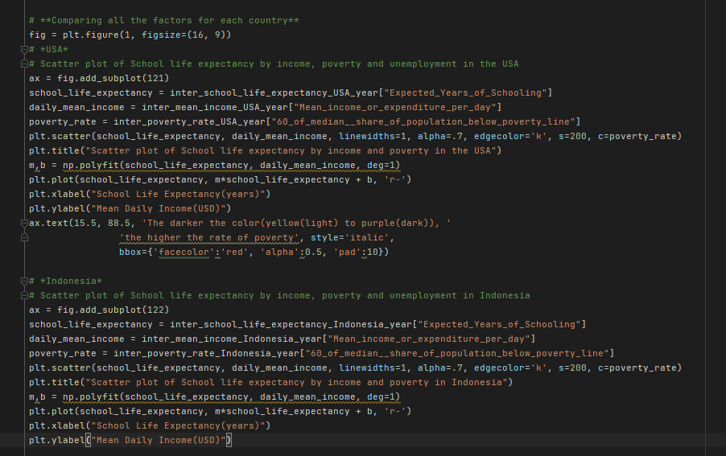
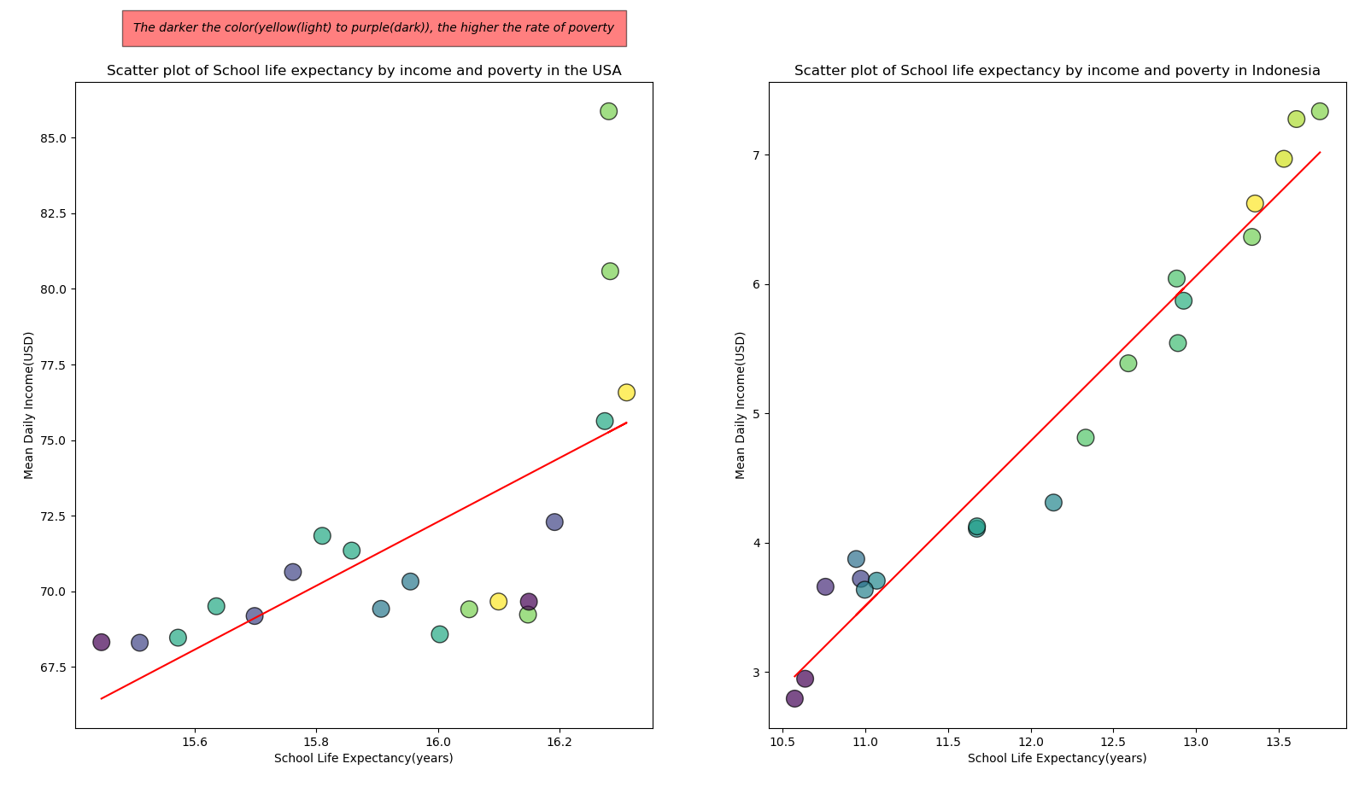
School Life Expectancy by income and poverty
Using plt.scatter and np.polyfit, we can create two bubble plots (or scatter plot) with a regression line each
On the left we have the bubble plot for USA and on the right we have Indonesia
Generally, for both countries, as the school life expectancy increases, the mean daily income increases.
For both graphs, the higher poverty rates are also more concentrated at the bottom left and the lower poverty rates at the top right.
This means that a lower school life expectancy results in both lower mean daily income as well as a higher poverty rate.

Slide 22
School Life Expectancy by income and poverty
There is a steeper increase in mean daily income in Indonesia as compared to USA, though the increase in dollars is lesser in Indonesia, with an increase of 5 dollars in comparison to USA’s increase of 8 dollars. However, the proportion of increase to mean daily income is a lot greater in Indonesia, hence the steeper regression line.
In USA, the high and low poverty rates feels randomly displaced, with some high poverty rates having high school life expectancies. The relationship between the two factors are hard to see
However, in Indonesia, the relationship between school life expectancy and poverty rates is easier to see. All the high poverty rate points are at the bottom left of the graph (low school life expectancy and mean daily income) while the low poverty rate points are at the top right of the graph (high school life expectancy and mean daily income)

Slide 23
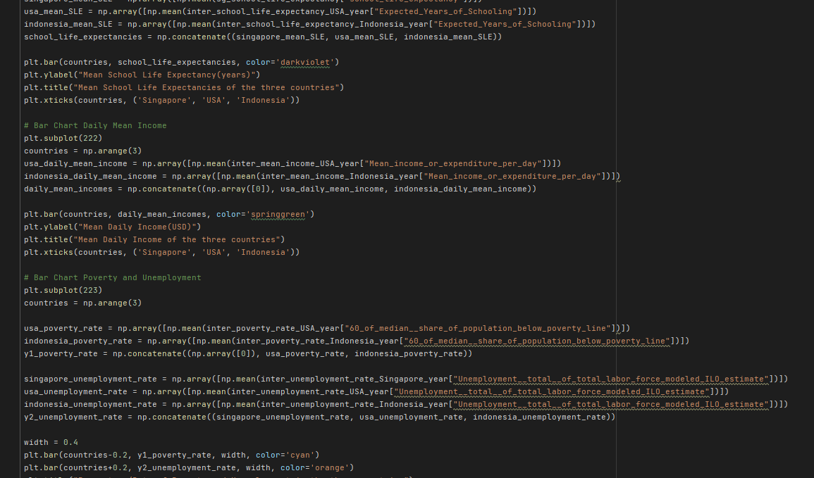
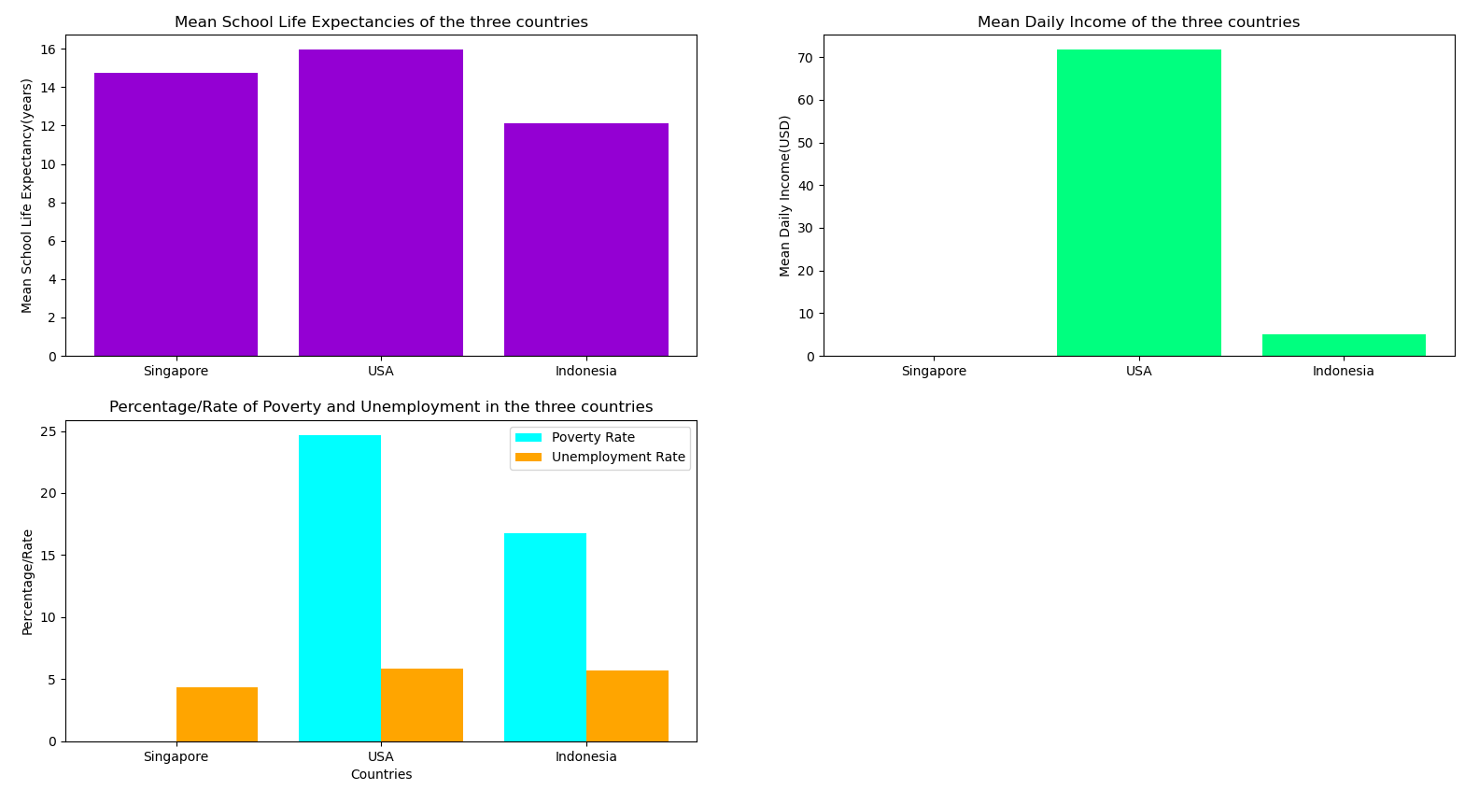
Comparison between the three countries
Using plt.bar, we can create two basic bar chats and one multiple variable bar chart
The mean school life expectancies differences between the three countries are rather small, with the difference between the highest and lowest being 4. USA has the highest school life expectancy, followed by Singapore, and lastly Indonesia.
Because of the mean school life expectancy, USA has a higher mean daily income compared to Indonesia
However, perhaps due to other factors, the rate of poverty in the USA is a lot higher than Indonesia, even though the unemployment rate is the same for the two of them.
The unemployment rate remains about the same for all three countries, despite the differences in school life expectancies

Slide 24
Conclusion
The school life expectancy does have some impact on the daily mean income and the poverty rate. It does not seem to have much of a impact on unemployment rate
As school life expectancy increases, daily mean income increases, unemployment and poverty rate decreases.
The amount of impact on each factors, however, varies between countries. A lower school life expectancy could have a great effect in mean income on a country, yet maybe for another country, it may not be that big (etc poverty rate USA & Indonesia).
This could be due to some other external factors.
This data analysis hence strengthens the importance of going to school, it can an opportunity for some to climb up the socio-economic ladder and seek a better life.

